Slide 1

Modelling Turbulent Transport For The Tokamak L-Mode Edge using Neural Networks
Bouvy Camille
Supervisors: Ronald Westra, Menica Dibenedetto, Jonathan Citrin, Karel van de Plassche

Slide 2
Section overview
Introduction
Dataset generation
Neural Network training and optimizing
Results and final model evaluation
Conclusion

Slide 3
Section overview
Introduction
Dataset generation
Neural Network training and optimizing
Results and final model evaluation
Conclusion

Slide 4
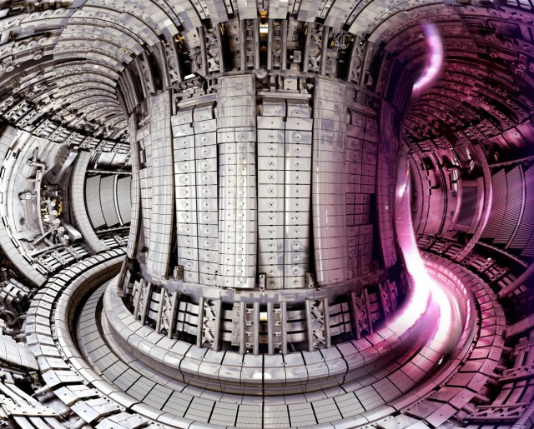
Nuclear Fusion
https://www.iter.org/
Notes:
For the past decades, researchers have been trying to reproduce the reaction powering the Sun and the stars: nuclear fusion. Nowadays, the leading approach to fusion energy are the tokamaks, the machine shown on this slide. However, as you can imagine, reproducing reactions powering the Sun on Earth is a very complex process, and it can lead to lots of instabilities. That is, researchers are currently working on accurate computational models predicting the heat and particle transport in such devices.
Unofortunately, those models exhibits a very considerable computational time

Slide 5
Turbulent Transport Models
QuaLiKiz
Reduced order turbulence model
QLKNN
Neural Network reproducing QuaLiKiz input-output mappings
Notes:
To cope with this issue, reduced order turbulence models have thus been developed. For instance, QuaLiKiz is a Quasilinear turbulence model invoking the quasilinear approximation. This allows to predict turbulent fluxes around six times faster than nonlinear codes. However, when applied into integrated modelling, it can still take a few days to run.
To further accelerate the computation, neural network surrogate models have been developed.

Slide 6
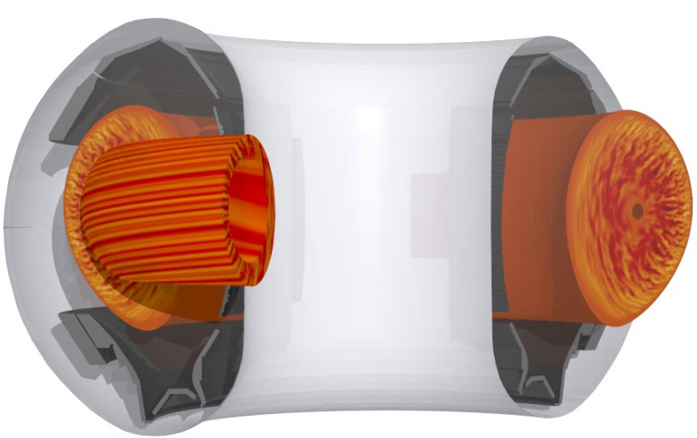
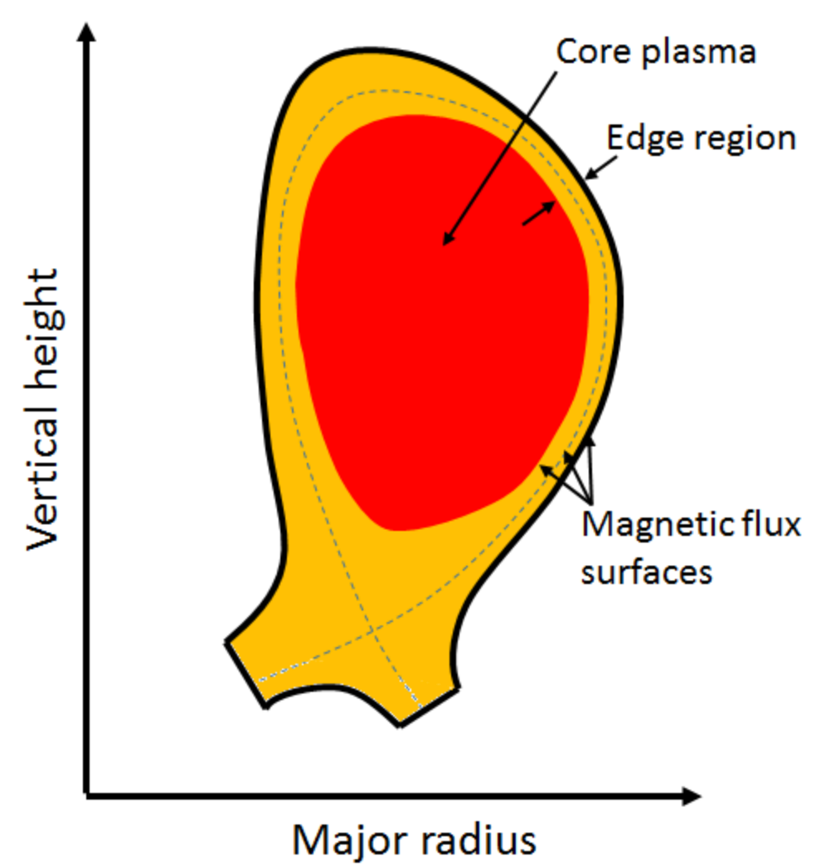

Nuclear Fusion: Tokamak Edge
https://www.genecode.org/
http://large.stanford.edu/courses/2014/ph241/zhang1
Notes:
QuaLiKiz Neural Network is valid for the bulk of the core region of a tokamak plasma. However, there is a transition region towards the edge region of a tokamak. This “near-edge” region in “L-mode” at low input power has relatively low temperatures, high logarithmic gradients, and high collisionality. Because of this parameter difference, this region can be considered in a different class than the rest of the tokamak plasma core.
This difference is very complex to capture with a unique regression model such as a Neural Network. To cope with this issue, a second neural network can be trained on a training set generated specifically for this region.
Left image: GENE taken from “citrin confinement presentation”
Right image: http://large.stanford.edu/courses/2014/ph241/zhang1/images/f1big.png

Slide 7
Section overview
Introduction
Dataset generation
Neural Network training and optimizing
Results and final model evaluation
Conclusion
Notes:
So the first step of this project was to generate a training set specific to the L-Mode Edge.

Slide 8
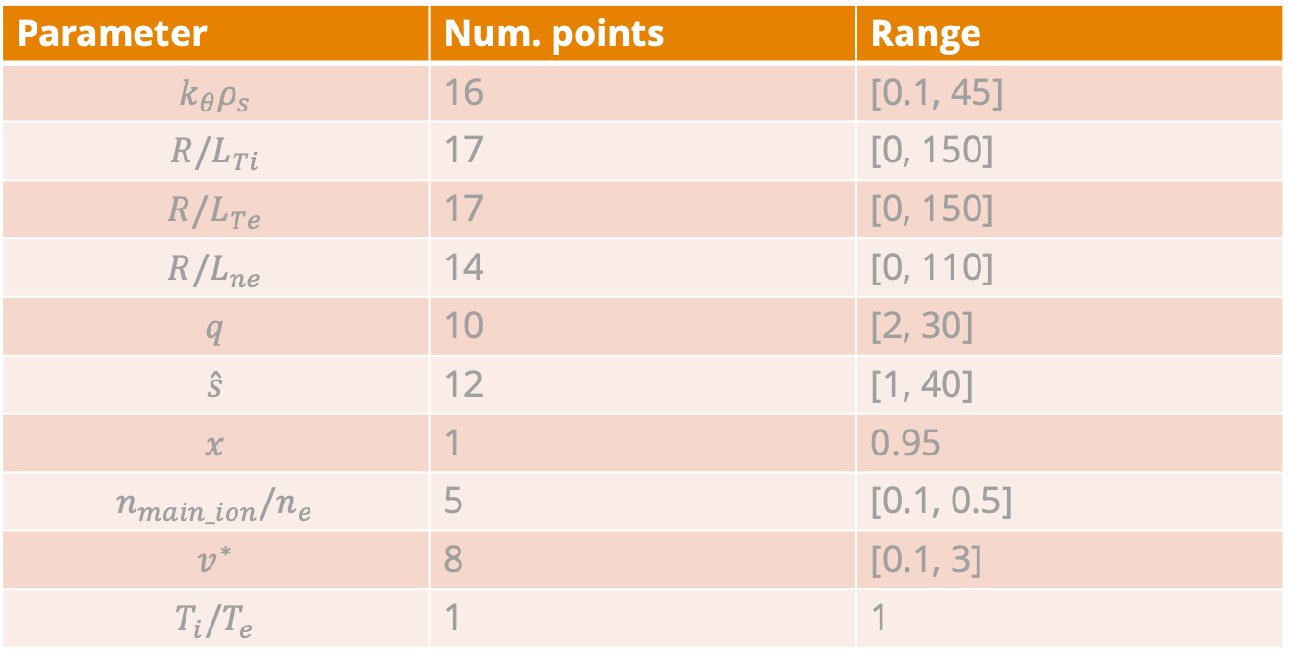
Input parameters selection
Parameter | Num. points | Range
$$k_{θ}ρ_{s}$$ | 16 | [0.1, 45]
$${R/L}_{Ti}$$ | 17 | [0, 150]
$${R/L}_{Te}$$ | 17 | [0, 150]
$${R/L}_{ne}$$ | 14 | [0, 110]
$$q$$ | 10 | [2, 30]
$$\hat{s}$$ | 12 | [1, 40]
$$x$$ | 1 | 0.95
$$n_{main_ion}/n_{e}$$ | 5 | [0.1, 0.5]
$$v^{∗}$$ | 8 | [0.1, 3]
$$T_{i}/T_{e}$$ | 1 | 1
Notes:
To that effect, the QuaLiKiz code is executed with a constrained input space. Those correspond to the dimensions that impact turbulent transport in the L-Mode the most.
These were picked based on previous experience, observations and physical knowledge to aim to cover realistic tokamak core parameter.
$k_{θ}ρ_{s}$ = sampled wavenumbers

Slide 9
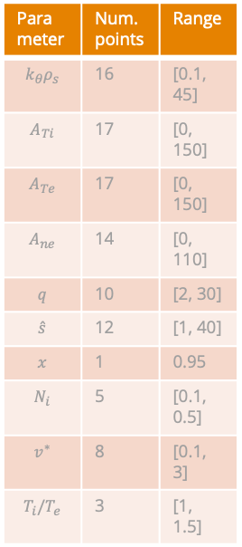
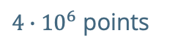

Dataset Generation
Parameter | Num. points | Range
$$k_{θ}ρ_{s}$$ | 16 | [0.1, 45]
$$A_{Ti}$$ | 17 | [0, 150]
$$A_{Te}$$ | 17 | [0, 150]
$$A_{ne}$$ | 14 | [0, 110]
$$q$$ | 10 | [2, 30]
$$\hat{s}$$ | 12 | [1, 40]
$$x$$ | 1 | 0.95
$$N_{i}$$ | 5 | [0.1, 0.5]
$$v^{∗}$$ | 8 | [0.1, 3]
$$T_{i}/T_{e}$$ | 3 | [1, 1.5]
QuaLiKiz
Output
NetCDF
One big NetCDF
Pandas Dataset
NetCDF
NetCDF
Pre-process
+ Filter
+ Convert to HDF5
Input
……..
NetCDF
NetCDF
NetCDF
4197 files
$5 ∙ {10}^{7}$ points
$4∙{10}^{6}$ points
Notes:
The workflow for the dataset generation is described on this slide. Once the input parameters were selected, QuaLiKiz was run with those. It outputted 4197 netCDF files (giving ion and electron heat flux and electron particle flux in different turbulence modes). All those files were then concatenated in one big one, which was pre-processed, filtered and finally converted to hdf5 for it to be in a format that the NN can be trained on. The points filtered out were untrusted QuaLiKiz outputs, so points with very small transport, points where ambipolarity is violated by more than 50% and points where the sum of the fluxes calculated in separate modes is over 50% more than the total flux. Moreover, all negative fluxes were clipped to zero.

Slide 10
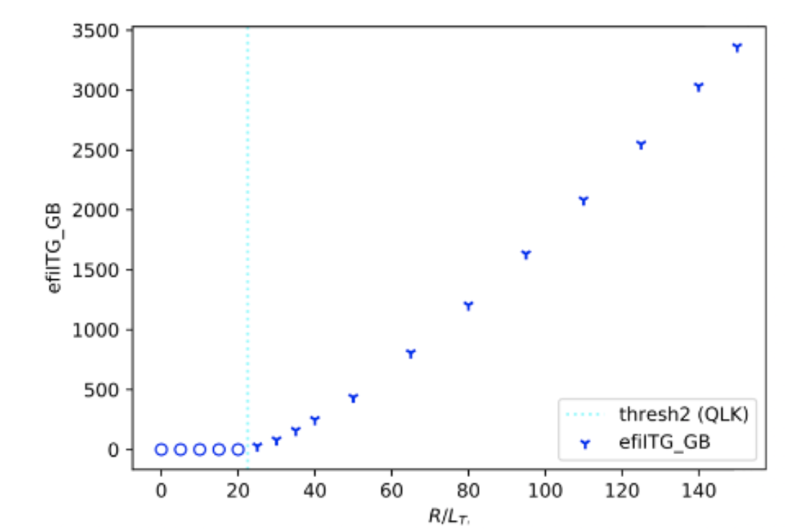
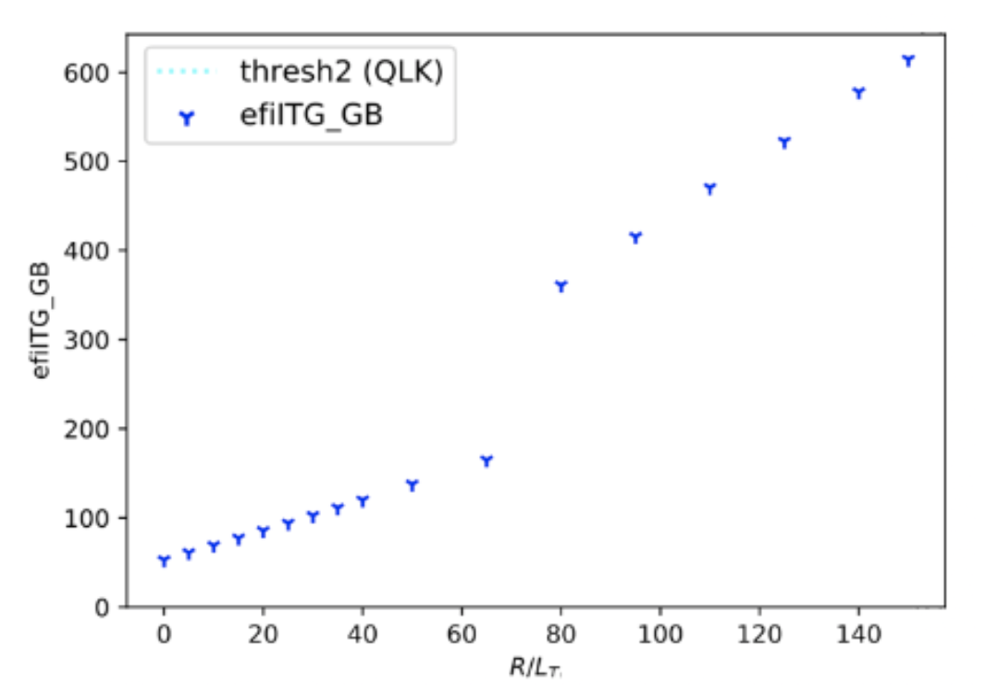
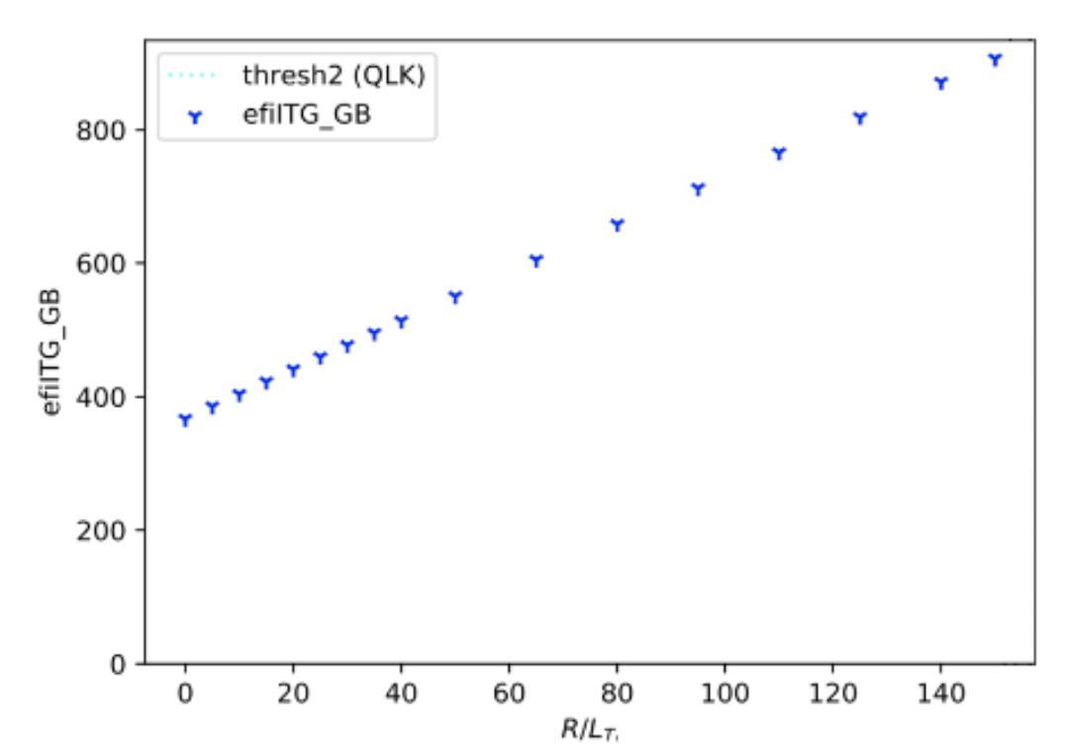
Data anomalies
“Normal” slice
Jump in flux
No threshold
Notes:
Ultimately, a standard slice of QuaLiKiz output resembles the one depicted in the left plot. Typically, the predicted fluxes are stable (so zero) until they hit the threshold. At this stage, they start to increase smoothly. Unfortunately, quite some data slices encompassed anomalies. For instance, the middle figure shows a data slice exhibiting a "sawtooth" behaviour. This irregularity is most likely originated by a problem in the numerics in this high temperature and density gradient regime. Additionally, as shown on the right plot, several slices do not possess a threshold. Those anomalies can negatively impact the model’s performance, as they are considered outliers to the training and represent a big part of the data.

Slide 11
Section overview
Introduction
Dataset generation
Neural Network training and optimizing
Results and final model evaluation
Conclusion
Notes:
Once the training set was generated, we could start training neural networks and optimizing it.

Slide 12

Neural Network
https://medium.datadriveninvestor.com/what-exactly-is-tensorflow-80a90162d5f1
Notes:
A neural network is a type of machine learning algorithm aiming to recognize underlying relationships in a set of data. When training a neural network, there are many parameters that can be tuned to give a good performance. Those are commonly called hyperparameters. In order to find the most optimal values for hyperparameters we used an algorithm called Grid Search. The best value is finally picked by evaluating all the network’s performances and choosing the values of the best one. But now how can we evaluate the model’s performances

Slide 13
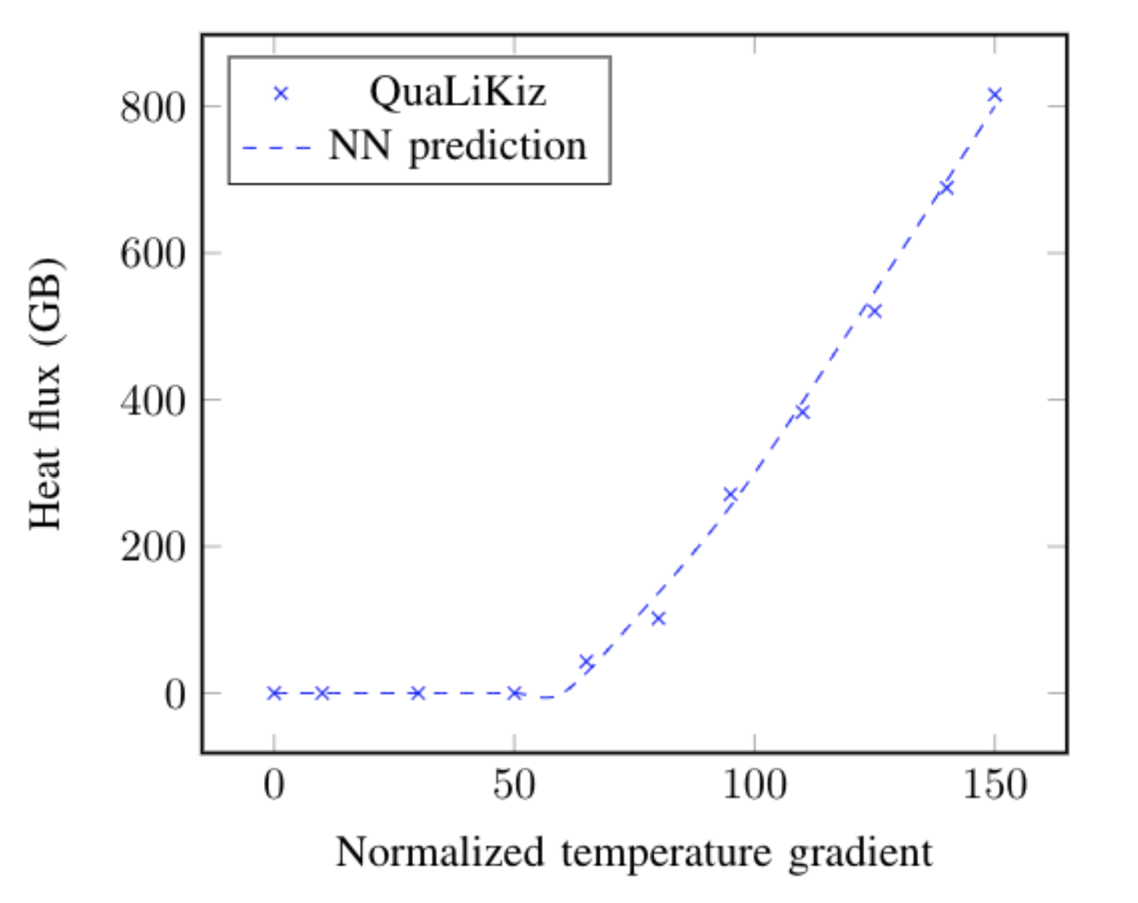
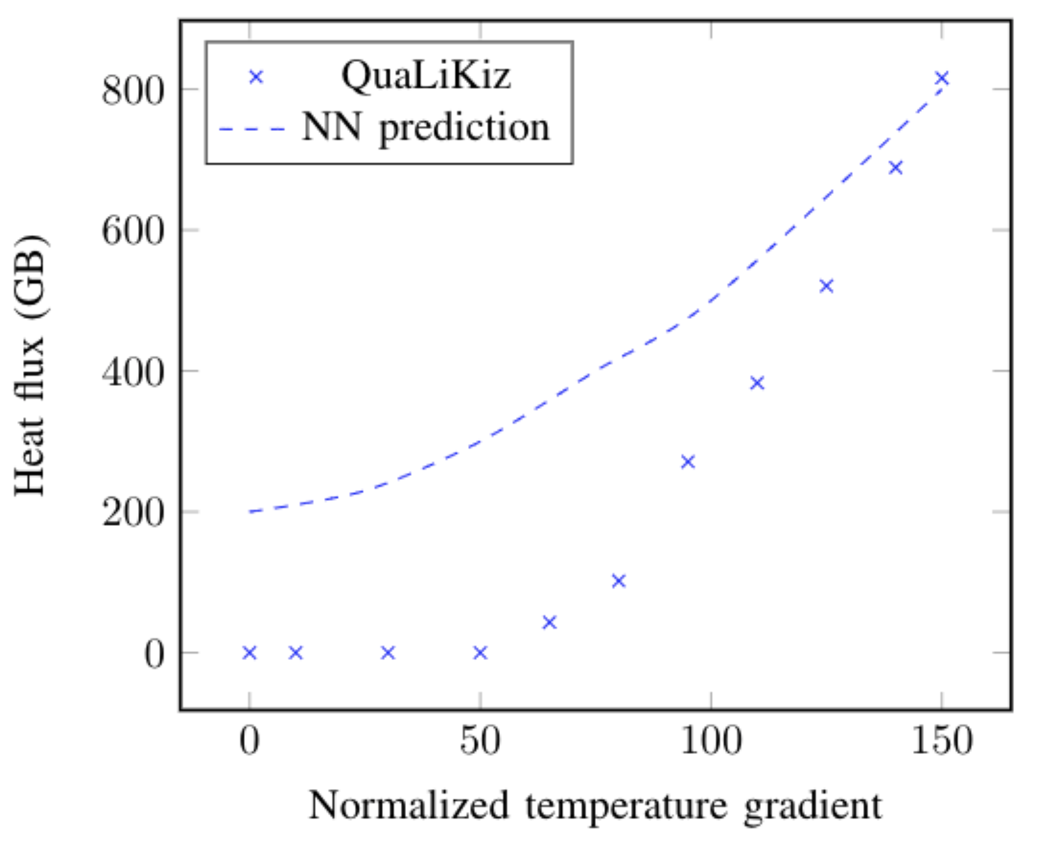
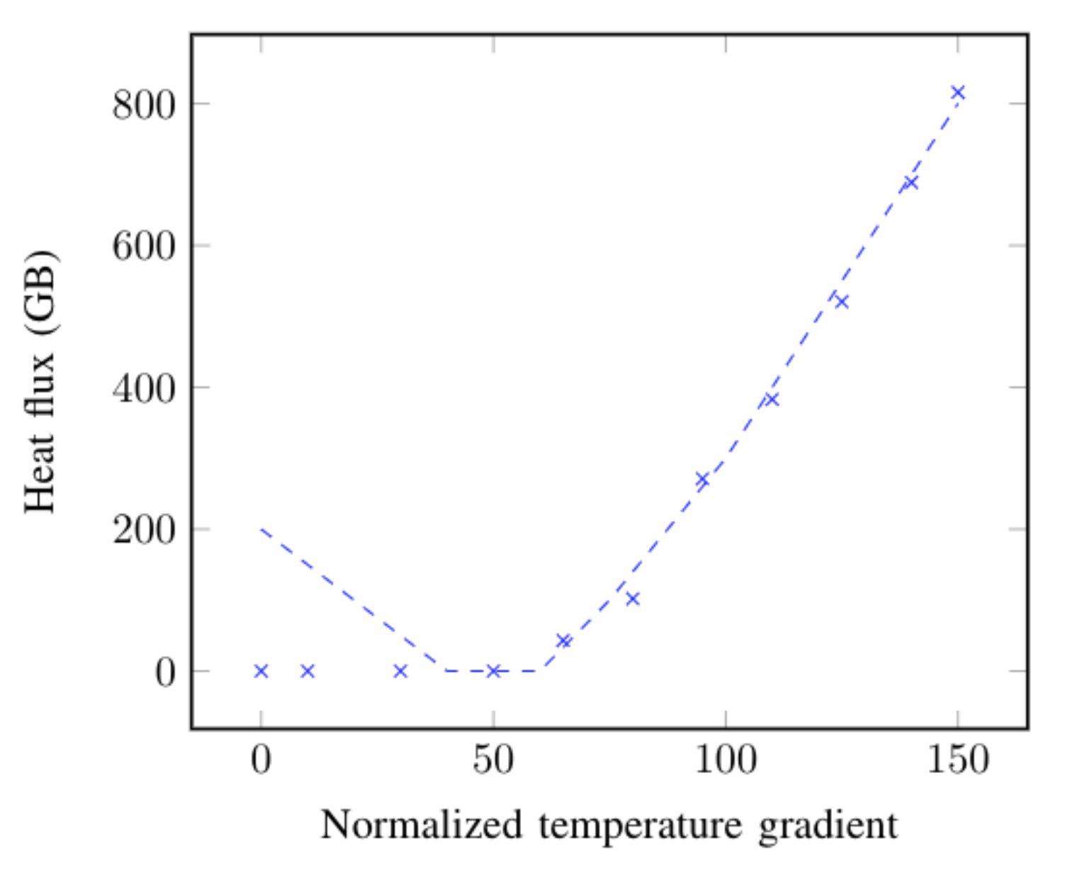
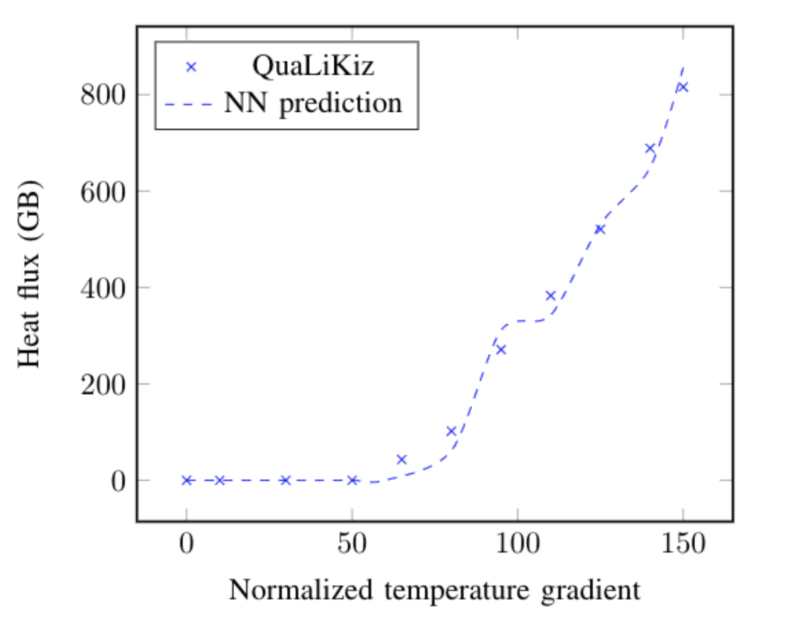
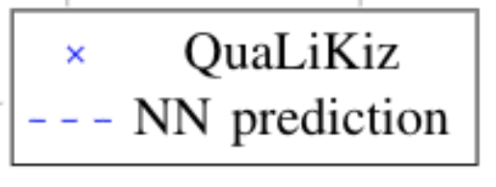
Measures of goodness
Root Mean Square Error (RMSE)
No threshold
“Pop-back”
Unsteadiness
Notes:
To evaluate the network’s performance, we typically computing how far the predictions are from target values. However, modelling of turbulent transport in fusion plasma is a task that can not be accurately evaluated using theses classical regression assessment methods. Some metrics can still give insight to determine the performance of the model. In this work, the goodness of the fit is analysed using the Root Mean Square Error (evaluating how close the prediction is to the target value). But the model also needs to capture certain physics features in order to be valid. As mentioned before, the model should predict a flux of zero in the stable region until it hits a threshold, where it starts smoothly increasing. Therefore, the performance can be evaluated by analysing whether there is a threshold, whether flux predictions are zero in the stable region or if there is a pop-back as shown on the 3rd plot and finally whether the curve is smooth after the threshold or unsteady.

Slide 14
Section overview
Introduction
Dataset generation
Neural Network training and optimizing
Results and final model evaluation
Conclusion

Slide 15
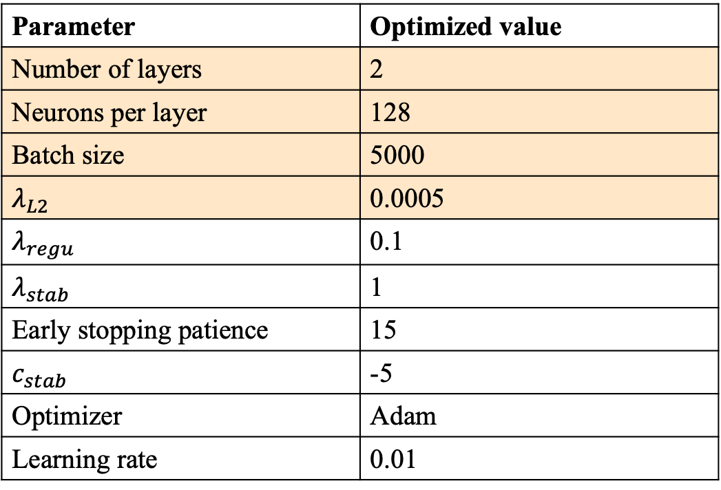
Final hyperparameter values
Parameter | Optimized value
Number of layers | 2
Neurons per layer | 128
Batch size | 5000
$λ_{L2}$ | 0.0005
$λ_{regu}$ | 0.1
$λ_{stab}$ | 1
Early stopping patience | 15
$c_{stab}$ | -5
Optimizer | Adam
Learning rate | 0.01
Notes:
The final hyperparameter values are displayed on this slide. Most of the hyperparameter values used for this NN were validated in previous work. As such, the default values used in the current state-of-the-art NN surrogate for these. The only hyperparameters optimized in this project are he number of hidden layers in the network, the number of nodes per hidden layer, the batch size and the regularization term L2. Those were chosen as they have a great influence on the model’s complexity. As mentioned before, those were selected as they performed best in the Grid Search algorithm with regards to the aforementioned metrics.

Slide 16
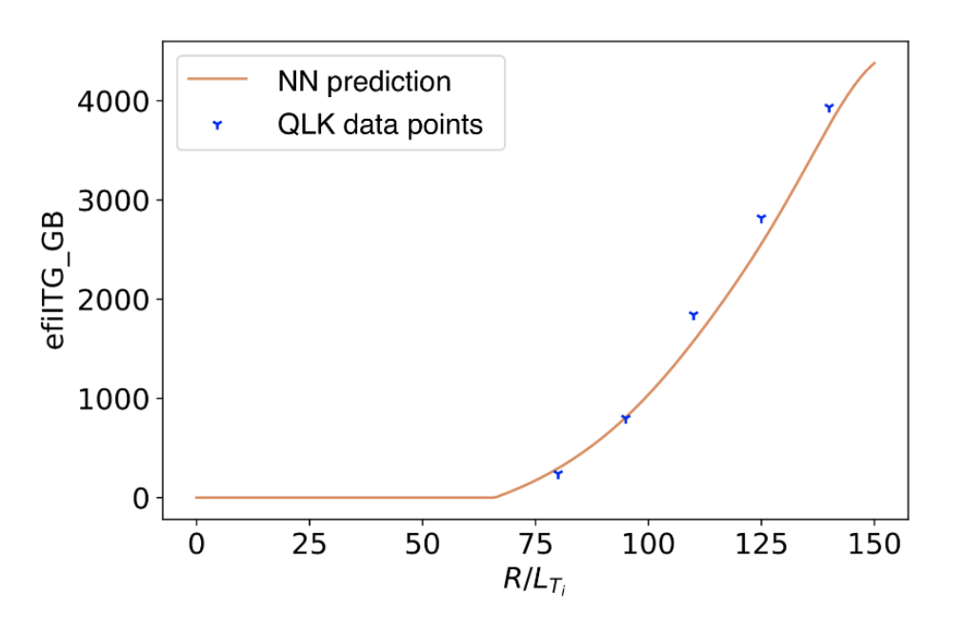
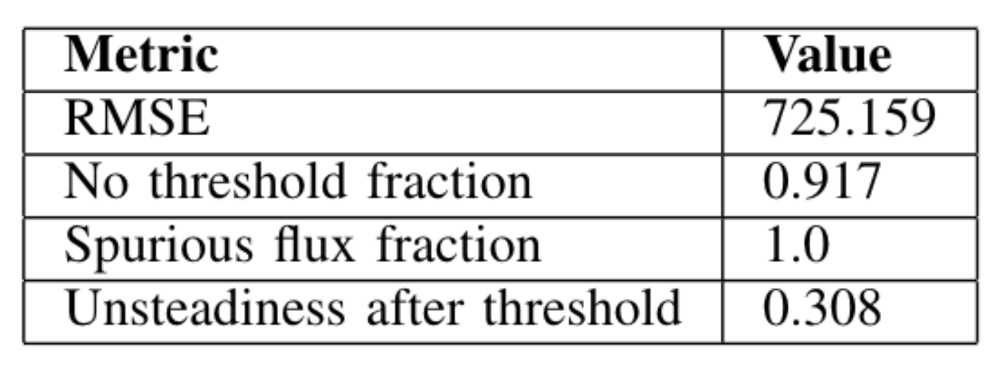
Final model
Notes:
Here is the performance of the final model. The Figure compares the neural network to the original QuaLiKiz evaluations, over a parameter scan of the ion temperature gradient. Looking at this plot, one can infer that the model fits the data points pretty well and this slice also exhibits the desired threshold behaviour. But it should be noted that since the dataset contains a significant amount of irregular slices, some of the network’s predictions are negatively affected. This is also reflected in the results of the metrics shown in the table. For instance, the no threshold fraction shows that in 91% of the cases, the model does not predict a threshold. However, only very few slices in the training set have a threshold themselves. So the network predicts the data correctly, but faulty data causes it to reproduce some erroneous data slices.
The spurious flux fraction indicates that the model never predicts pop-backs in the 10% of cases where it has a threshold, which is an indication of good performance there. The Root Mean Square Error and unsteadiness after threshold were among the most optimal values of the models in the grid search. The network’s performance was also investigated by visual inspection. This confirmed that the predictions were smooth, and generally not too far off the target values.

Slide 17
Section overview
Introduction
Dataset generation
Neural Network training and optimizing
Results and final model evaluation
Conclusion
Notes:
And finally to conclude

Slide 18
Conclusion
Trained a neural network on a newly generated dataset
Future work
Revising dataset and filtering out the anomalies
Implementing NN into an integrated model
Generate another QuaLiKiz dataset with more data points
Notes:
Within this work, a QuaLiKiz dataset for the L-mode edge parameter space was built, and was used as a training set for a neural network. This resulted in a network performing ostensibly well.
Future work is foreseen in re-training the neural networks on a dataset comprising less anomalies and irregularities. The first step towards a cleaner dataset could be to apply the temperature gradient breakdown filter, a filter that we were not able to apply in this work due to an Out Of Memory error in the code. A longer-term goal would be to include all networks for all fluxes (as in this work only the ion heat flux in ITG mode was investigated) and to implement the networks in integrated models such as JINTRAC. This would allow to assess the model’s performance more accurately and with less reliance on visual judgement. Finally, it would be worthwhile to generate another QuaLiKiz dataset including more data points (for instance including the ion electron temperature ratio values 1.25 and 1.5), and benchmark neural networks trained on each dataset to one another

Slide 19
References
K . L. van de Plassche, J. Citrin, C. Bourdelle, Y. Camenen, F. J. Casson,V. I. Dagnelie, F. Felici, A. Ho, S. V. Mulders, and J. Contributors, “Fast modeling of turbulent transport in fusion plasmas using neural networks,” in Invited Papers from the 2nd International Conference on Data-Driven Plasma Science, 2020
A. Ho, “Development of neural networks towards predict-first plasma modelling,” Ph.D. dissertation, Applied Physics, Mar. 2021
C. Bourdelle, J. Citrin, B. Baiocchi, A. Casati, P. Cottier, X. Garbet, and F. I. “Core turbulent transport in tokamak plasmas: bridging theory and experiment with QuaLiKiz,” Plasma Physics and Controlled Fusion, vol. 58, no. 1, dec 2015
Rick Zhang, “Design Considerations of Plasma Facing Components in Tokamak Fusion Reactors”, March 5, Stanford University, 2014
S. Haykin, Neural Networks: A Comprehensive Foundation, 2nd ed. Prentice Hall, July 1998
A. B. Jim ́enez, J. L. L ́azaro, and J. R. Dorronsoro, Finding Optimal Model Parameters by Discrete Grid Search. Berlin, Heidelberg : Springer Berlin Heidelberg, 2007, p. 120–127
https://www.differ.nl/

Slide 20
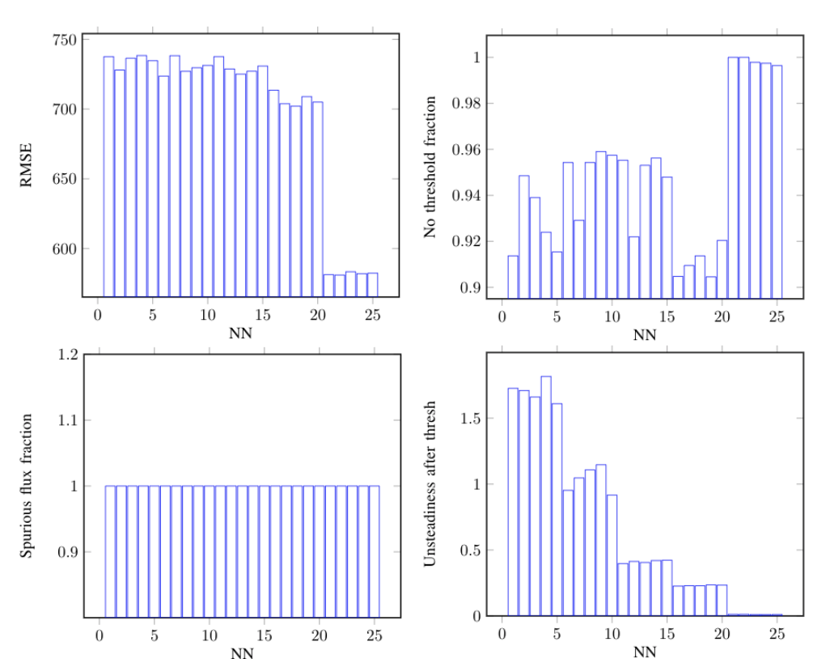
Grid Search: L2 cost and batch size

Slide 21
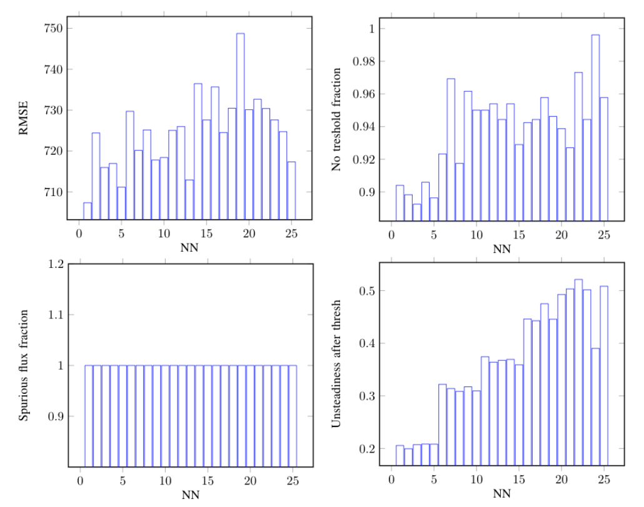
Grid Search: Number of hidden layers and nodes per layer

Slide 22
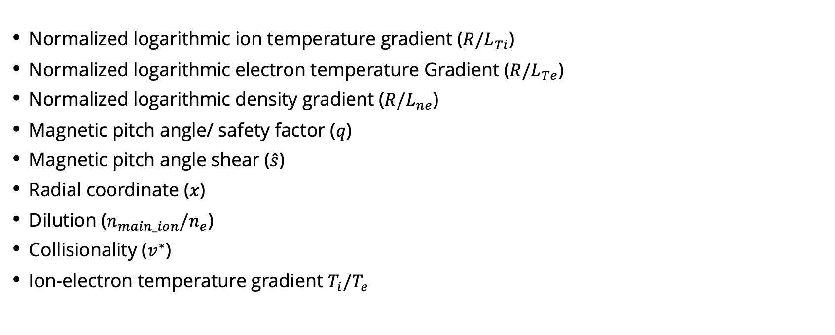
Input parameters selection
Normalized logarithmic ion temperature gradient (${R/L}_{Ti}$)
Normalized logarithmic electron temperature Gradient (${R/L}_{Te}$)
Normalized logarithmic density gradient (${R/L}_{ne}$)
Magnetic pitch angle/ safety factor ($q$)
Magnetic pitch angle shear ($\hat{s}$)
Radial coordinate ($x$)
Dilution ($n_{main_ion}/n_{e}$)
Collisionality ($v^{∗}$)
Ion-electron temperature gradient $T_{i}/T_{e}$

Slide 23
Data Filtering
Points with negative heat flux
Points where ambipolarity is violated by more than 50%
Points with very tiny transport (≤1×10−4GB units)
Points where the sum of the fluxes calculated in separate modes is over 50% more than the total flux

